Slide 1

Porting MLEM Algorithm for Hetetogeneous Systems
Technical University of Munich
Department of Informatics
Mengdi Wang
Bachelor’s Thesis
Informatik: Games Engineering
29th August, Garching

Slide 2
Agenda
Background
MLEM Algorithm
Matrix Transposition
Merge-based SpMV
CSR-vector SpMV
SpMV-T using No Transposed Matrix
NCCL Operations
Experiments and Results
Conclusions

Slide 3
Agenda
Background
MLEM Algorithm
Matrix Transposition
Merge-based SpMV
CSR-vector SpMV
SpMV-T using No Transposed Matrix
NCCL Operations
Experiments and Results
Conclusions

Slide 4
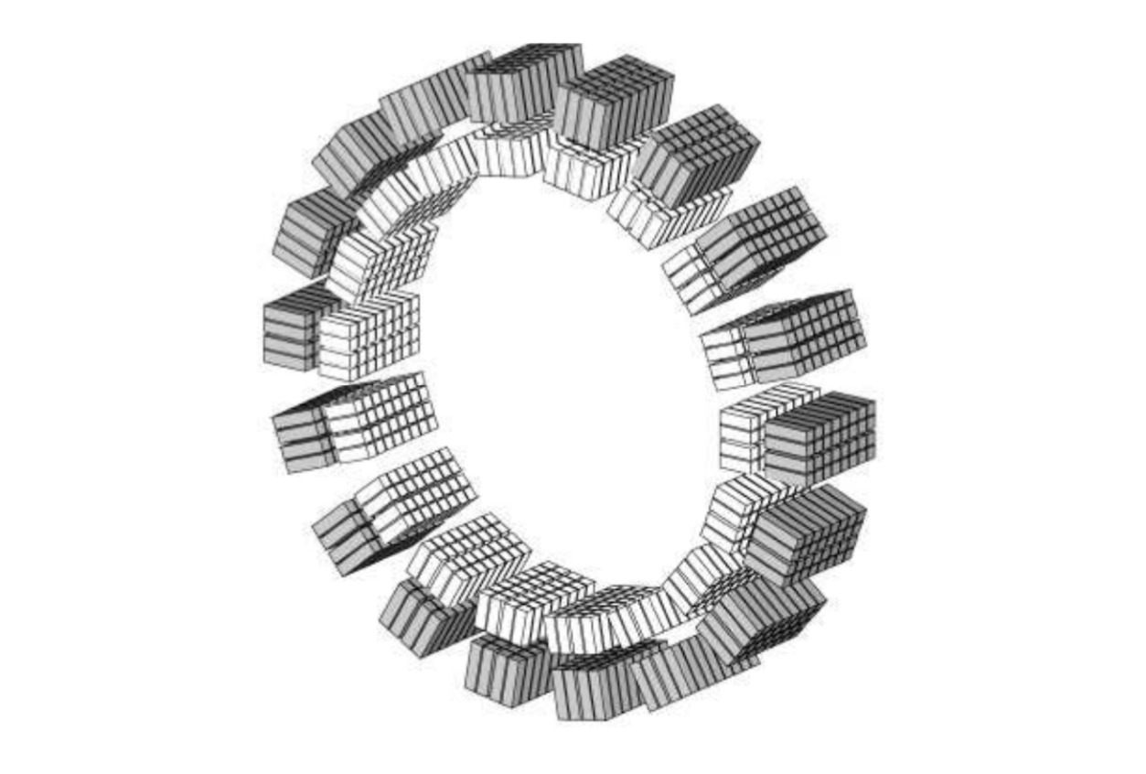
Background
Positron Emission Tomography (PET)
Matrix A: characterizing PET scanner
Image g: recorded by PET scanner
Aim: solve the liear equation system A · f = g
Program written in C / C++ / CUDA
MADPET-II Scanner

Slide 5
Agenda
Background
MLEM Algorithm
Matrix Transposition
Merge-based SpMV
CSR-vector SpMV
SpMV-T using No Transposed Matrix
NCCL Operations
Experiments and Results
Conclusions

Slide 6
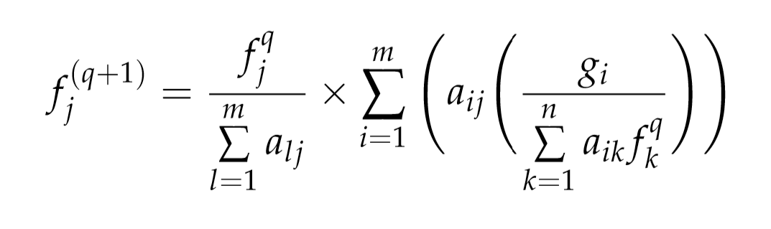
MLEM Algorithm
Maximum Likelihood reconstruction (ML)
using Expectation Maximization (EM)
An iterative algorithm

Slide 7
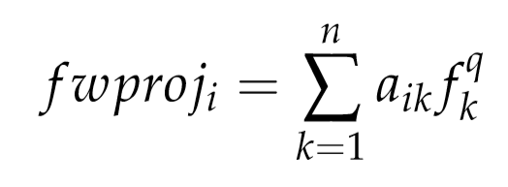
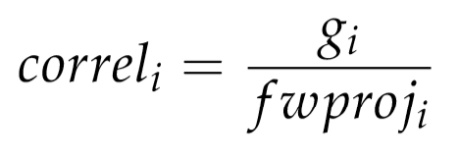
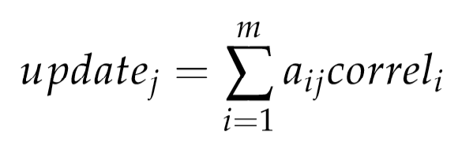
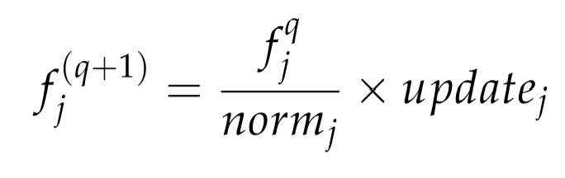
MLEM Algorithm
Forward Projection
Correlation
Backward Projection
Update

Slide 8
MLEM Algorithm
Forward Projection equivalent to matrix-vector multiplication
Correlation scaling
Backward Projection equivalent to matrix-vector multiplication
if transposed matrix A^{T} provided
Update scaling

Slide 9
Agenda
Background
MLEM Algorithm
Matrix Transposition
Merge-based SpMV
CSR-vector SpMV
SpMV-T using No Transposed Matrix
NCCL Operations
Experiments and Results
Conclusions

Slide 10
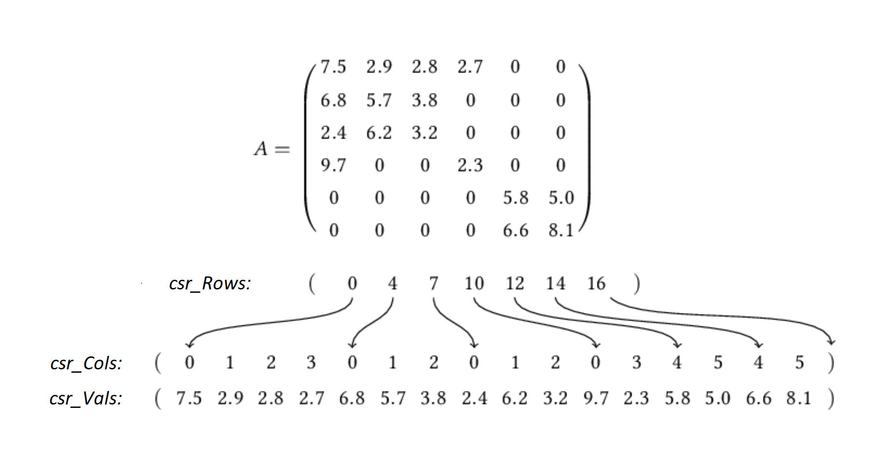
Matrix Transposition
Matrix format: CSR (Compressed Sparse Row)

Slide 11
Matrix Transposition
NVIDIA CUSPARSE, Intel MKL, AMD CML…
ScanTrans: parallel, applying openMP, O(m+n+nnz)
Reference
H. Wang, W. Liu, K. Hou, W. Feng (Virginia Tech) Parallel Transposition of Sparse Data Structures

Slide 12
Agenda
Background
MLEM Algorithm
Matrix Transposition
Merge-based SpMV
CSR-vector SpMV
SpMV-T using No Transposed Matrix
NCCL Operations
Experiments and Results
Conclusions

Slide 13

Merge-based SpMV
Matrices in PET reconstruction are normally very sparse
about 12.8 GB
1,327,104 rows
784,000 columns
only 1,603,498,863 nnzs
sparsity 99.85%
“busiest” row: 6537 nnzs
“laziest” row: only 1 nnz

Slide 14
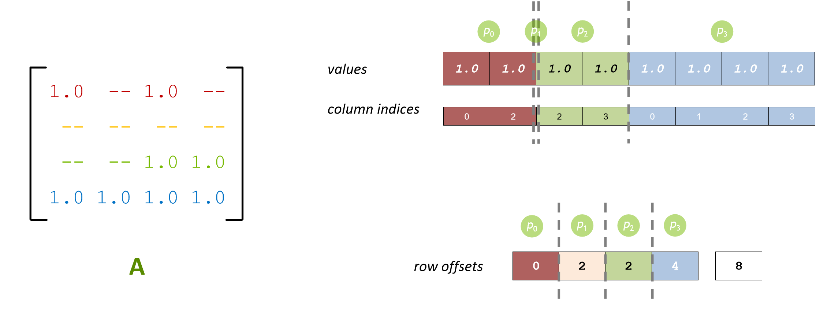
Merge-based SpMV
Naive approach: row-based partition
Imalance in colum vector and in value vector

Slide 15
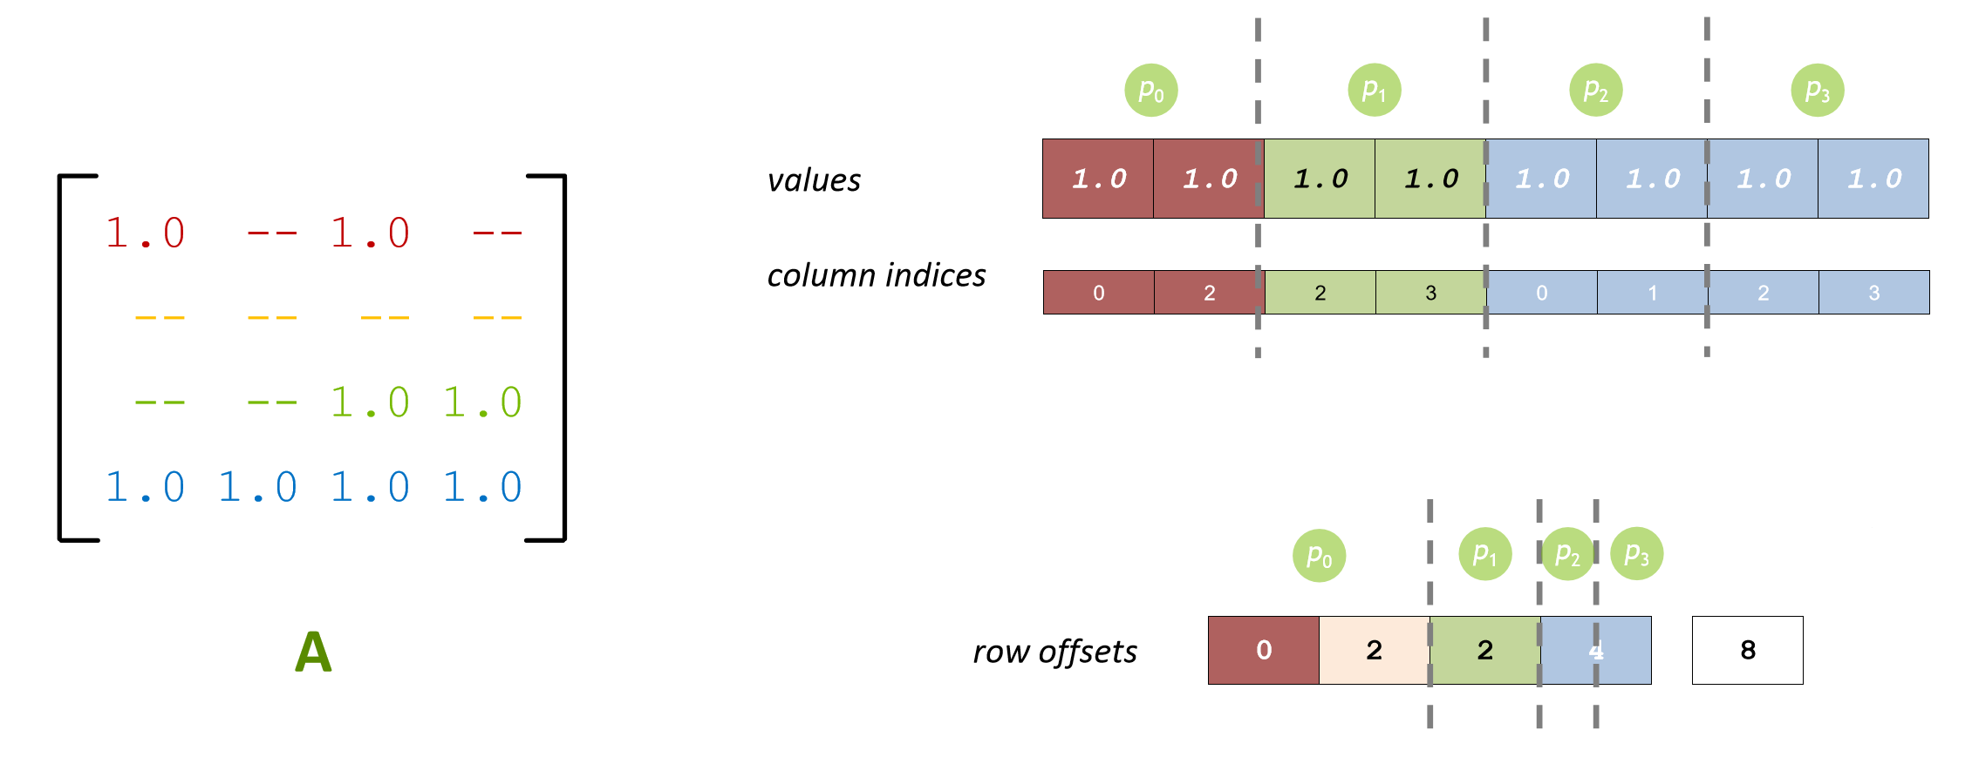
Merge-based SpMV
Better: nnz-based partition
Imbalance in row vector

Slide 16
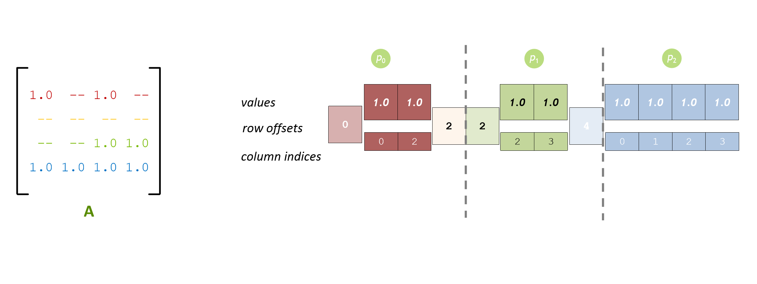
Merge-based SpMV
Even better: merge-based partition
Each element is either a nnz or a row switch Pros: well-balanced Cons: atomic operations
Reference: D. Merrill, M. Garland (NVIDIA, 2016) Merge-based Sparse Matrix-Vector Multiplication (SpMV) using the CSR Storage Format

Slide 17
Agenda
Background
MLEM Algorithm
Matrix Transposition
Merge-based SpMV
CSR-vector SpMV
SpMV-T using No Transposed Matrix
NCCL Operations
Experiments and Results
Conclusions

Slide 18
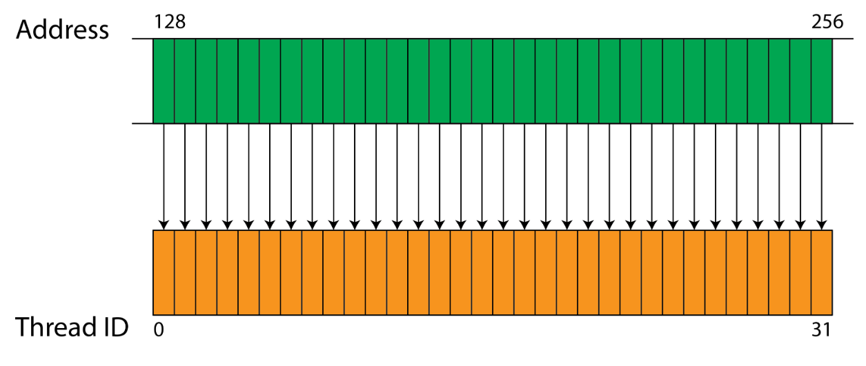
CSR-vector SpMV
Coalesced memory access: contiguous threads in a warp access neighbor memory a addresses (32 threads per warp)
Reference
N. Bell, M. Garland (NVIDIA, 2008)
Eﬃcient Sparse Matrix-Vector Multiplication on CUDA

Slide 19
CSR-vector SpMV
Naive approach: row-based partition, each thread one row
Novel approach: row-based partition, each warp one row
In column vector and value vector:
Thread 0: access memory position 0, 32, 64…
Thread 1: access memory position 1, 33, 65…
…
Thread 31: access memory position 31, 63, 95…
Memory access always coalesced
Pros: coalesced, shared memory, less atomic Cons: imbalance

Slide 20
Agenda
Background
MLEM Algorithm
Matrix Transposition
Merge-based SpMV
CSR-vector SpMV
SpMV-T using No Transposed Matrix
NCCL Operations
Experiments and Results
Conclusions

Slide 21
SpMV-T using No Transposed Matrix
Recap: backward projection is equivalent to a (sparse) matrix-vector aaaaaamultiplication, only if the transposed matrix A^{T} is available
But: use of transposed matrix not always possible
Example: 128 GB GPU memory vs 100 GB matrix
Reference
Apoorva Gupta (TUM, 2018)
Implementation and Evaluation of MLEM-Algorithm on GPU using CUDA

Slide 22
Agenda
Background
MLEM Algorithm
Matrix Transposition
Merge-based SpMV
CSR-vector SpMV
SpMV-T using No Transposed Matrix
NCCL Operations
Experiments and Results
Conclusions

Slide 23
NCCL Operations
More than 1 GPU are used, because:
Matrix too large to be stored on single GPU
The more, the faster
Solution:
Partition original matrix into smaller matrices
Each GPU works with one smaller matrix
Consequence:
Each GPU holds only part of the result

Slide 24
NCCL Operations
 | on GPU 0
 | on GPU 1
 | on GPU 2
A
x =
 | 0
 | 1
 | 2
b
x

Slide 25
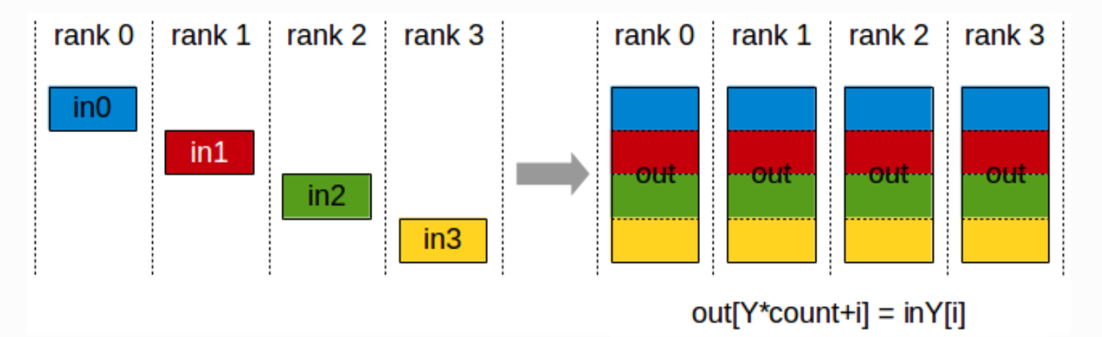
NCCL Operations
Aim: to “concatenate” result vectors over GPUs
Solution: NCCL (NVIDIA Collective Communication Library)
Primary idea: ncclAllGather

Slide 26
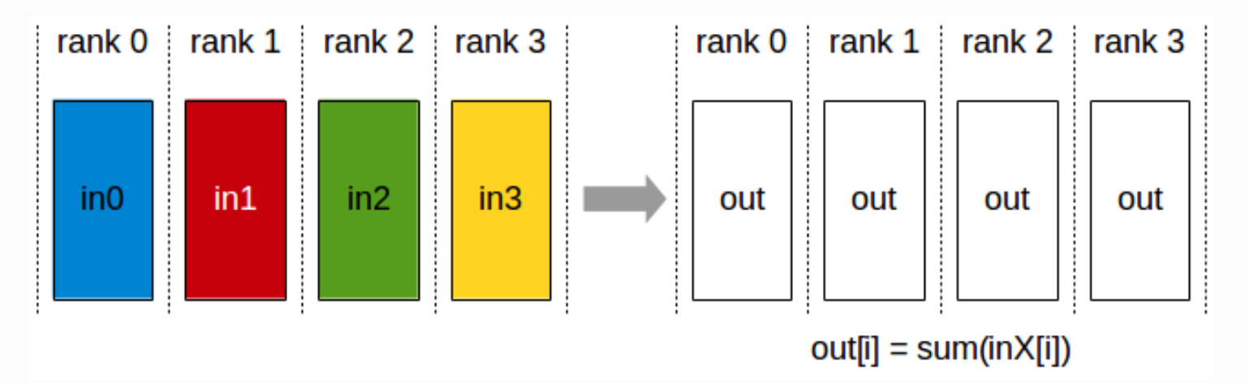
NCCL Operations
However, prerequisites: vectors of same size
Matrix partitioned evenly according to nnzs, not according to rows
Solution: ncclAllReduce + ncclSum

Slide 27
Agenda
Background
MLEM Algorithm
Matrix Transposition
Merge-based SpMV
CSR-vector SpMV
SpMV-T using No Transposed Matrix
NCCL Operations
Experiments and Results
Conclusions

Slide 28
Experiments and Results
Most of pre-processing works are done on CPU:
Load matrix into CSR format
Calculate norms
Transpose matrix
Partition matrix into smaller matrices
Others are done on GPUs:
FP, BP, Correlation, Update
(if using merge-based SpMV) partition smaller matrices into sections

Slide 29
Experiments and Results
Platforms:
AMD Ryzen Threadripper 2990WX + NVIDIA Quadro P6000 GPU memory size 24 GB
DGX-1 V100 with eight NVIDIA Tesla V100 Total GPU memory size 128 GB
Matrices:
About 12.8 GB, sparsity 99.85% 1.3 million rows, 0.8 million column, 1.6 billion nnzs used on both platforms
About 100 GB, sparsity 99.91% 5.3 million rows, 2.6 million column, 12.3 billion nnzs used solely on DGX-1

Slide 30
Experiments and Results
Focus: performance of forward & backward projection
Two different implementations of forward projection:
1. using csr-vector SpMV
2. using merge-based SpMV
Three different implementations of backward projection:
1. using csr-vector SpMV
2. using merge-based SpMV
3. using no transposed matrix

Slide 31
Experiments and Results
 |  | avg time cost per iteration | absolute bandwidth | relative bandwidth
FP (csr-vector) | 2 GPUs 8 GPUs | 8.418ms 2.136ms | 1525.30 GB/s 6011.24 GB/s | 85.02% 83.77%
FP (merge-based, secsize=5) | 2 GPUs 8 GPUs | 29.580ms 7.306ms | 434.08 GB/s 1757.46 GB/s | 24.20% 24.49%
BP (csr-vector) | 2 GPUs 8 GPUs | 7.939ms 2.012ms | 1617.33 GB/s 6381.71 GB/s | 90.15% 88.93%
BP (merge-based, secsize=5) | 2 GPUs 8 GPUs | 28.100ms 6.898ms | 456.94 GB/s 1861.41 GB/s | 25.47% 25.94%
BP (no transposed matrix) | 2 GPUs 8 GPUs | 13.046ms 3.292ms | 982.21 GB/s 3900.36 GB/s | 54.86% 54.35%
On DGX-1:
12.8 GB matrix, 500 MLEM iterations

Slide 32
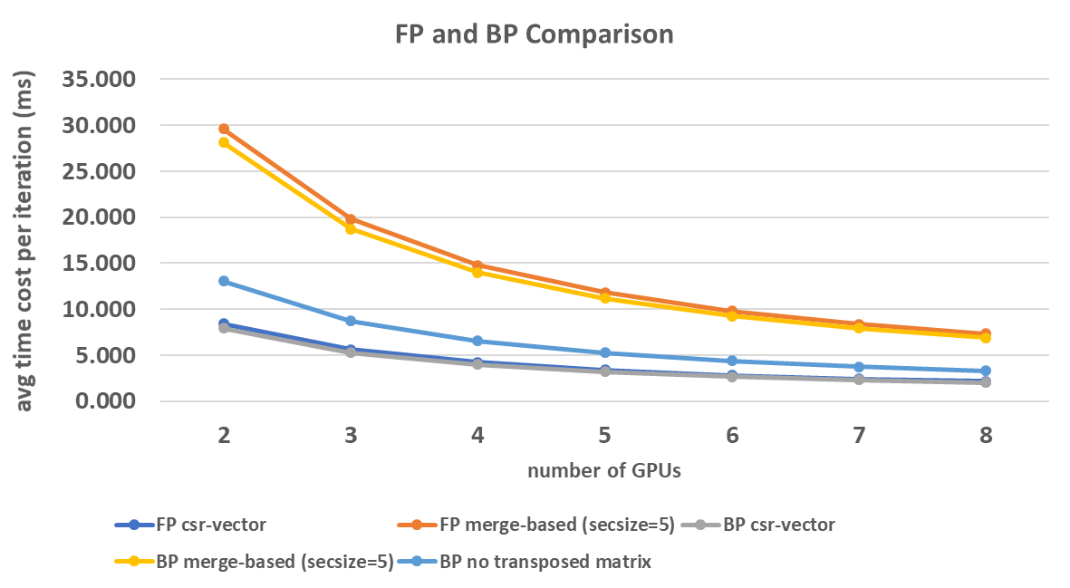
Experiments and Results
On DGX-1: 12.8 GB matrix, 500 MLEM iterations

Slide 33
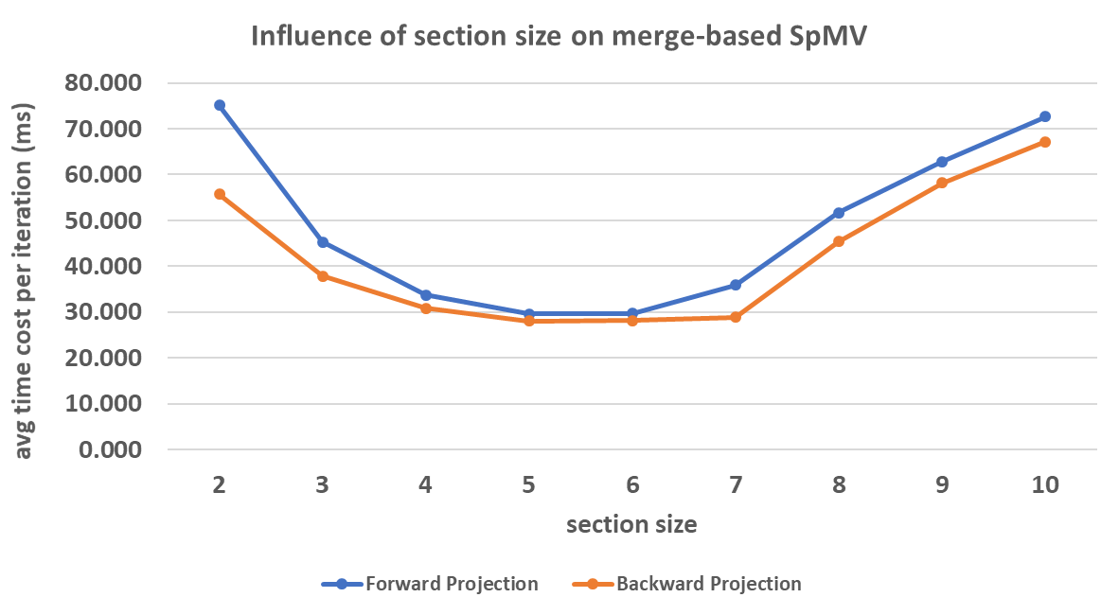
Experiments and Results
On DGX-1: 12.8 GB matrix, 500 MLEM iterations, 2 GPUs
Effective bandwidth in best case: FP BP (secsize=5 for both) 434.06 GB/s (24.2%) 457.36 GB/s (25.49%)

Slide 34
Experiments and Results
Extreme case: on DGX-1, 100 GB matrix, 10 MLEM iterations, 8 GPUs
 | avg time cost per iteration | absolute bandwidth | relative bandwidth
FP (csr-vector) | 16.498ms | 5972.85 GB/s | 83.23%
BP (no transposed matrix) | 2.092s | 47.1 GB/s | 6.56%

Slide 35
Agenda
Background
MLEM Algorithm
Matrix Transposition
Merge-based SpMV
CSR-vector SpMV
SpMV-T using No Transposed Matrix
NCCL Operations
Experiments and Results
Conclusions

Slide 36
Conclusions
Discovery about performance:
CSR-vector always the most efficient (relative effective bandwidth > 80%)
Merge-based always the most inefficient (relative effective bandwidth < 30%)
SpMV-T using no transposed matrix:
relatively efficient, when matrix not too large (13 GB matrix: 54%)
fairly inefficient, when matrix extremely large (100 GB matrix: 6.6%)

Slide 37
Thank you very much for your concentration!
Mengdi Wang, BA
Munich, 29th August 2019, Garching

